Slide 1
B10 - From Chaos to Clarity: A Lightweight Support System
Hackathon – IIT Bhilai
Team name - 444
1

Slide 2

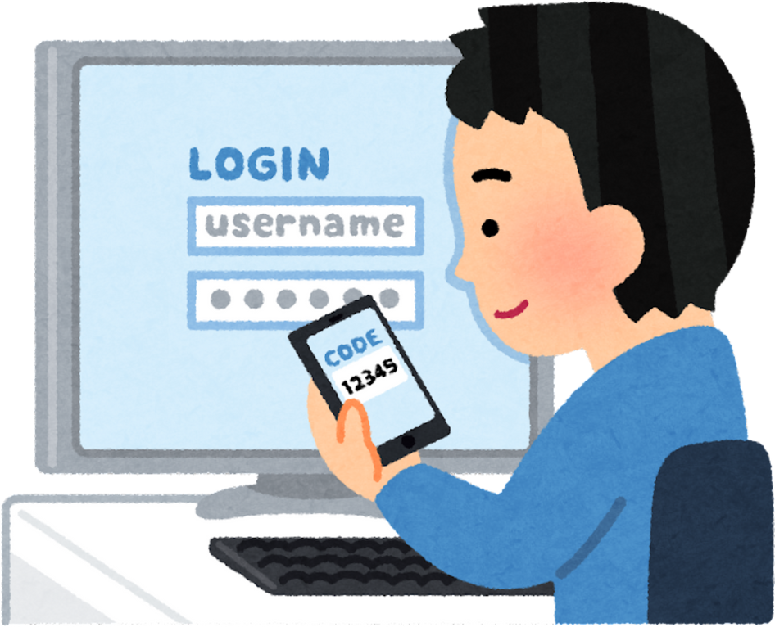





User faces an issue
Issue Reported Informally
Login not working
Message • Email • Verbal
No Ownership
No Central Tracking
“Someone else will handle it”
No ticket • No record
2

Slide 3

The problem
Issues have:
No identity
No ownership
No visibility
Support requests arrive from everywhere — messages, emails, and conversations.
They are discussed, forwarded, and promised… but never properly tracked.
As a result, problems are forgotten, users follow up repeatedly, and support teams struggle to keep track.
An issue that is not tracked is an issue that is not solved.
3

Slide 4

One Rule: One ticket , One Agent
Our solution
Every Ticket Has Ownership
All Communication Lives Inside the Ticket
No scattered chats.
Updates
Clarifications
Fix notes
Each ticket is:
Assigned to one agent
Visible to everyone involved
This removes:
“Someone else is handling it”
Confusion and blame
Everything stays attached to the ticket.
4

Slide 5
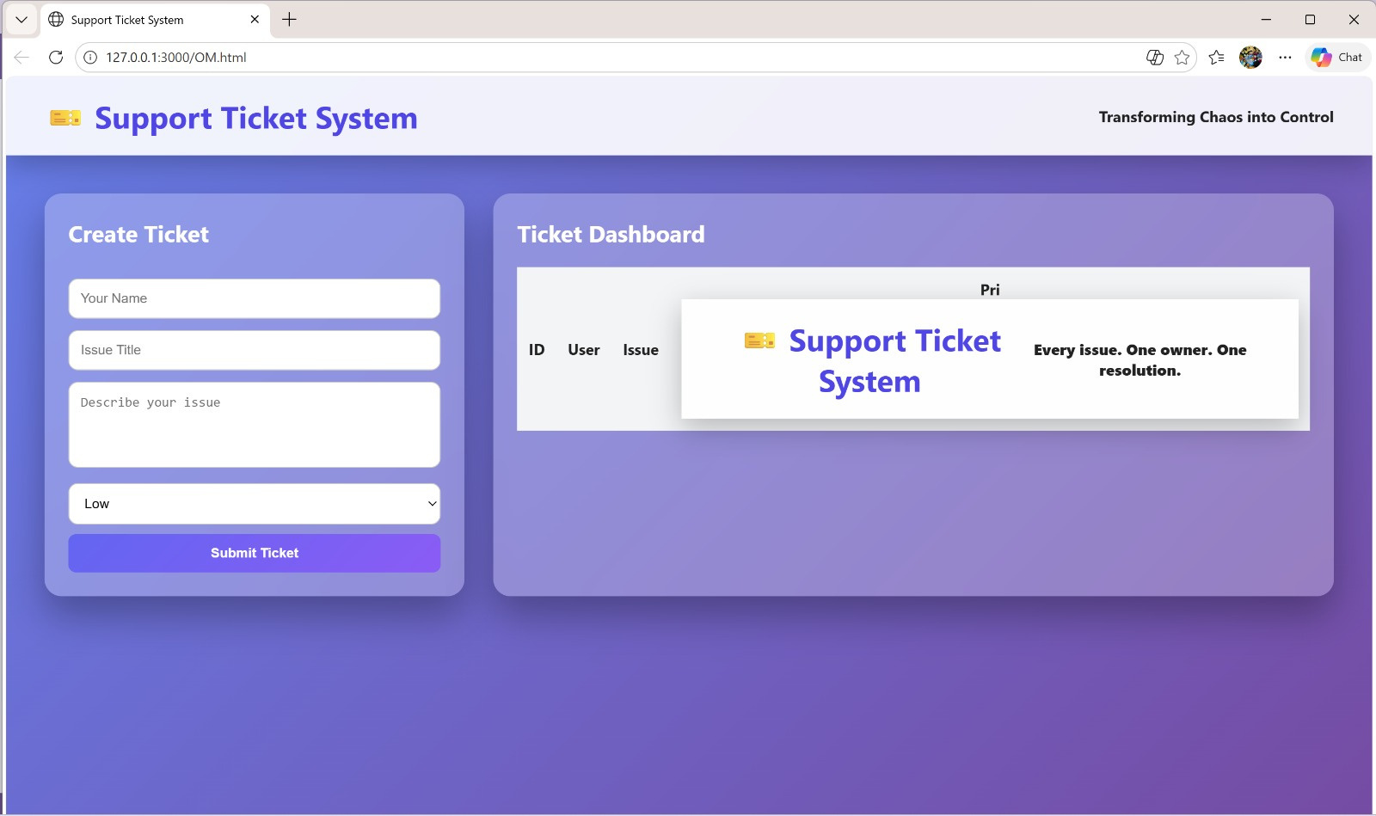
5

